Slide 1
Advanced Internetworking

Slide 2
Group Members
ID Number Name
IT19360874 Perera H.A.K.D
IT19206738 Jayasekera P.Y.R
IT19082066 Kasthuriarachchi S.D
IT19206288 Liyanage R.S.H

Slide 3
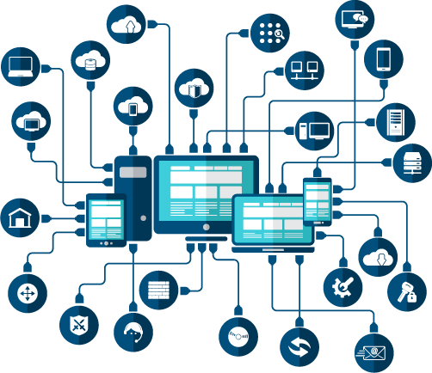
Introduction
This presentaion includes steps taken to design and impliment a network for local education Institute and the proper maintainance plan for the network.

Slide 4
Network Design
1
Blueprint of the Network

Slide 5
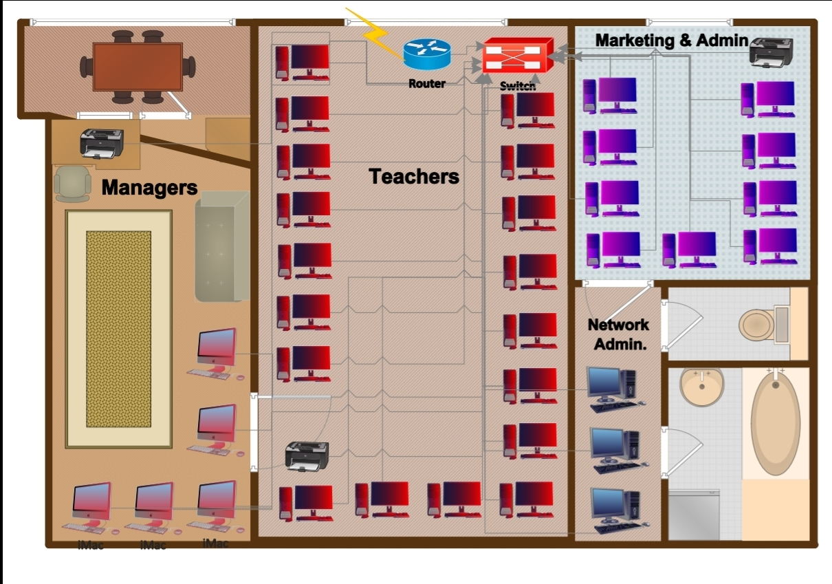
Ground Floor

Slide 6
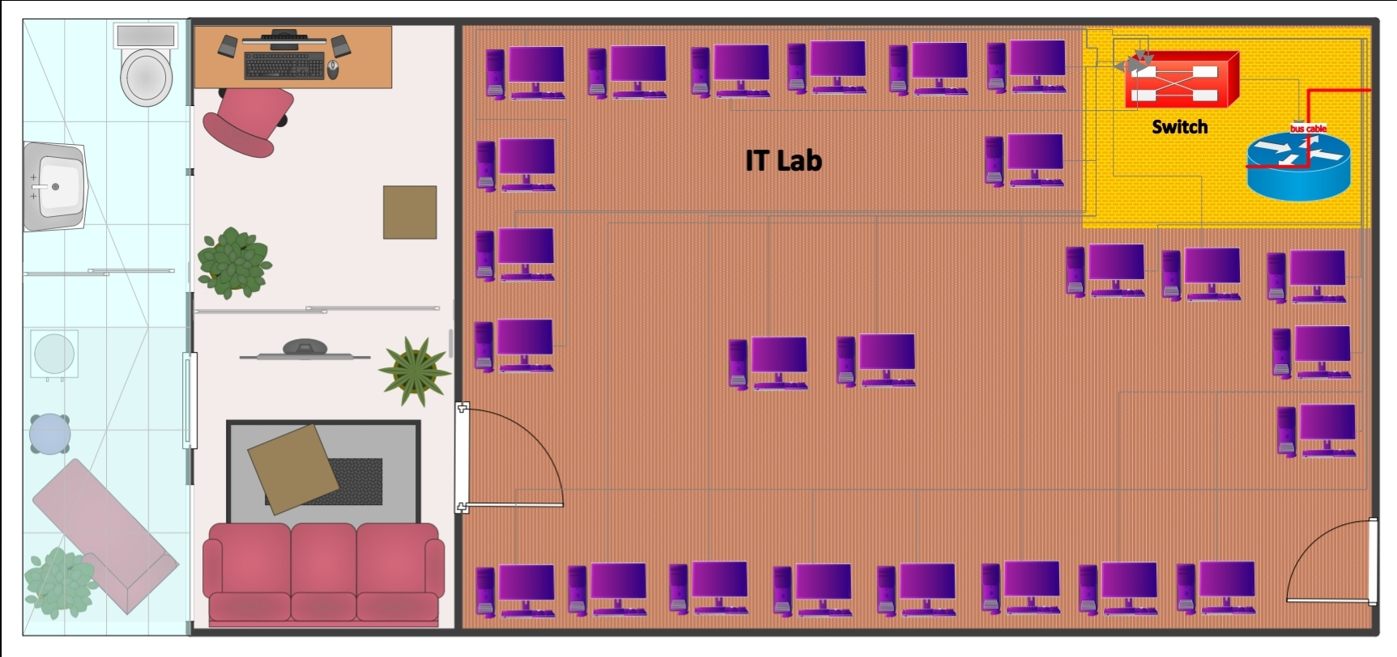
First Floor

Slide 7
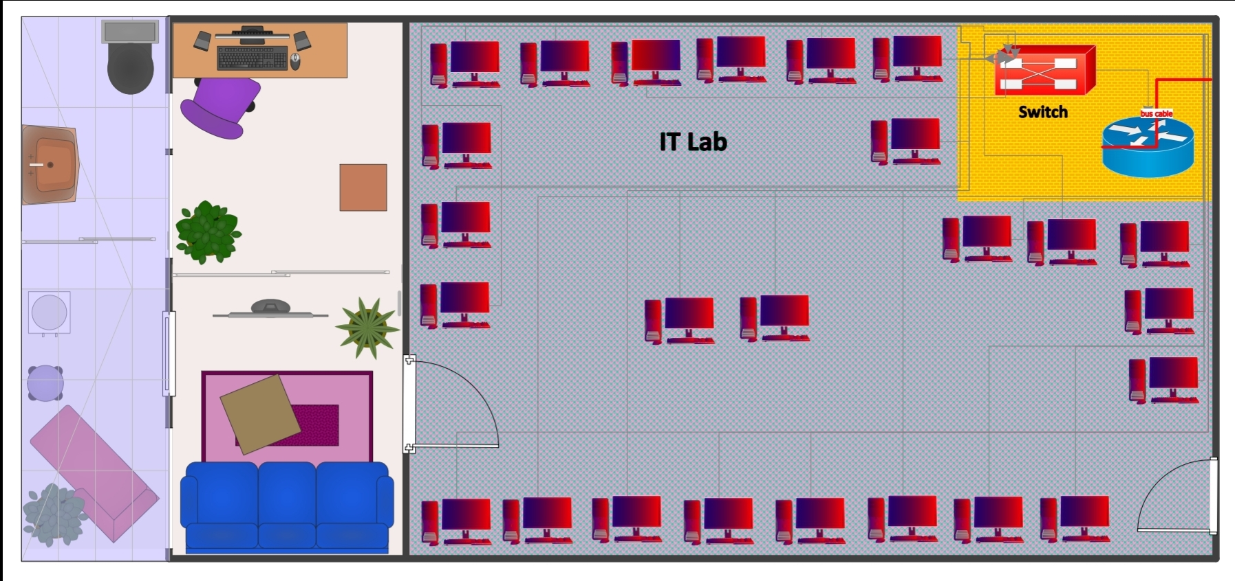
Second Floor

Slide 8
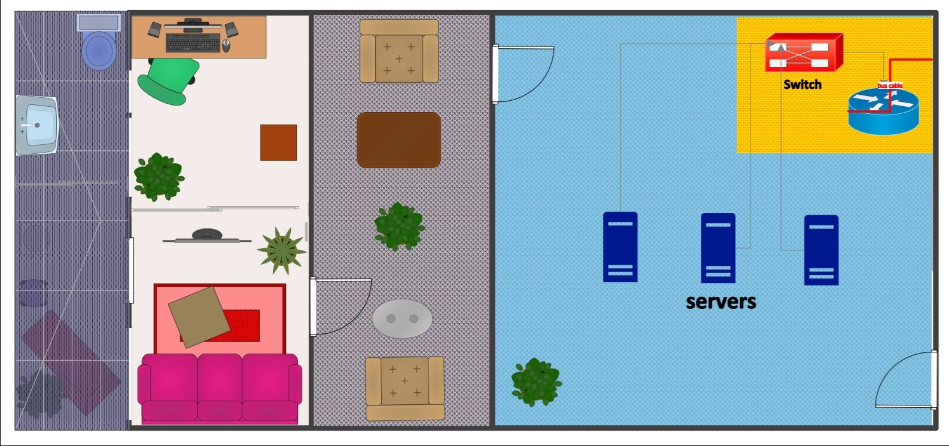
Third Floor

Slide 9
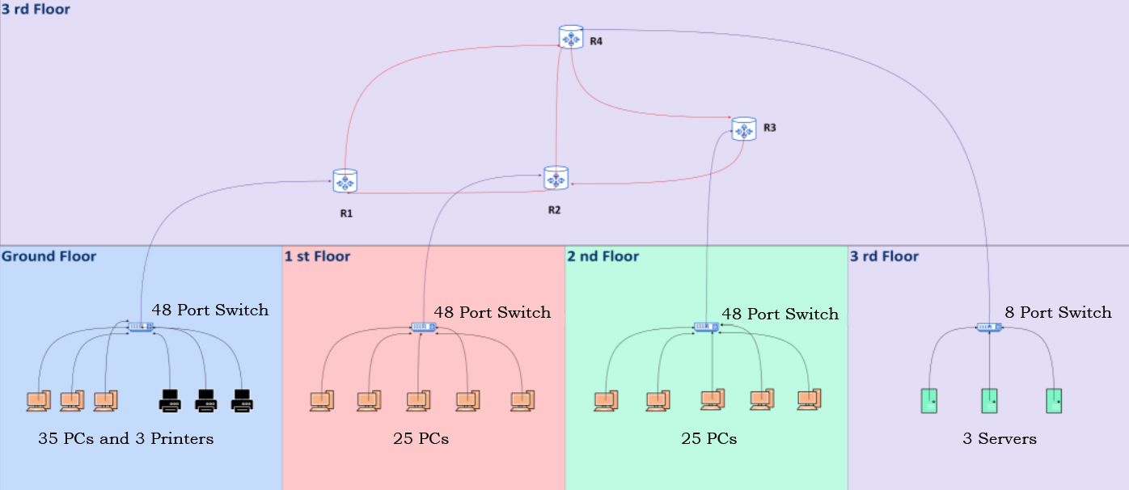
Blueprint of the Network

Slide 10
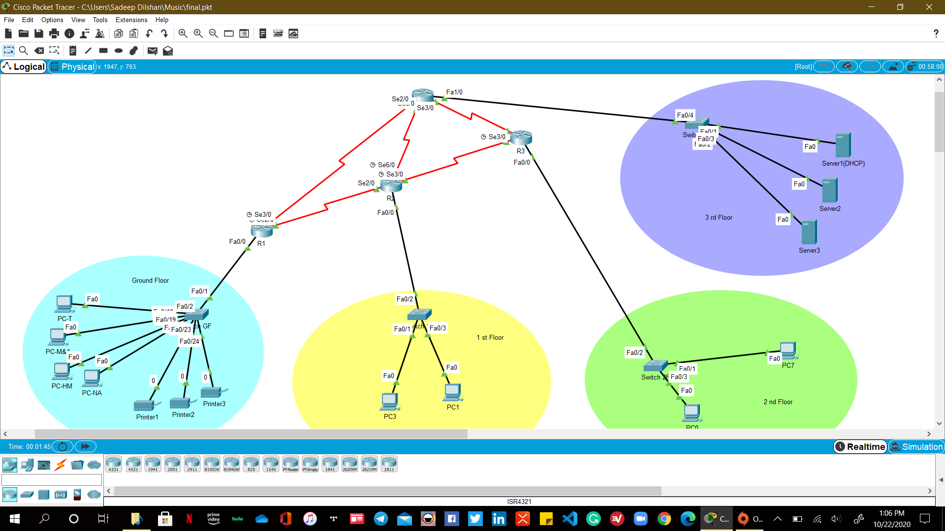
Packet tracer Design

Slide 11
Devices Used
4 Routers
4 Switches ( 3 48 Port Switches & a 8 Port Switch)
3 Servers
50 Computers ( 25 computers each for 2 IT labs)
35 Computers (staff)
3 Printers
Teachers – 18PCs
Marketing & Administration -9 PCs
Higher Managers -5 PCs
Network Administrators – 3 PCs

Slide 12
Routing Protocol
The RIPv2 protocol used in this design because the minimal number of routers are used.
The Hop-count is considered rather than the Cost (bandwidth).
It sends triggered updates if the network changes.

Slide 13
Comparing RIPv1 and RIPv2
This network uses RIPv2 since RIPv1 is outdated.
It is more secure and supports manual route summarization.
Provide trigger updates as wellRIPv2 use Multicast traffic for updates.
It supports for VLSM and discontinuous networks.

Slide 14
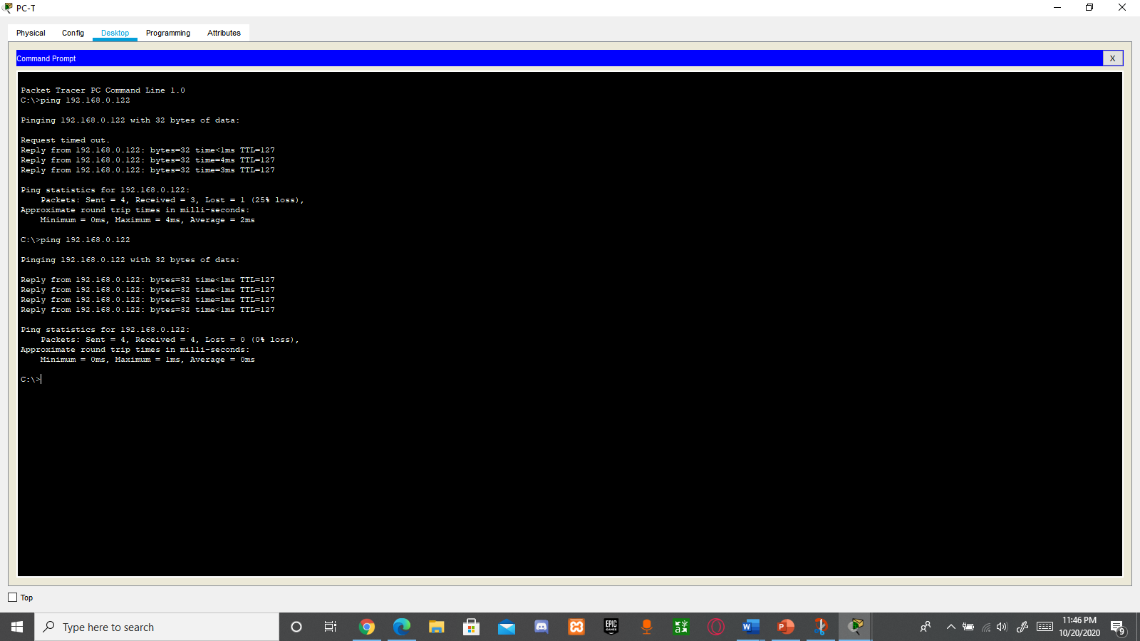
Network Verification
Ping within the inter-vLan(PC T to PC NA)

Slide 15
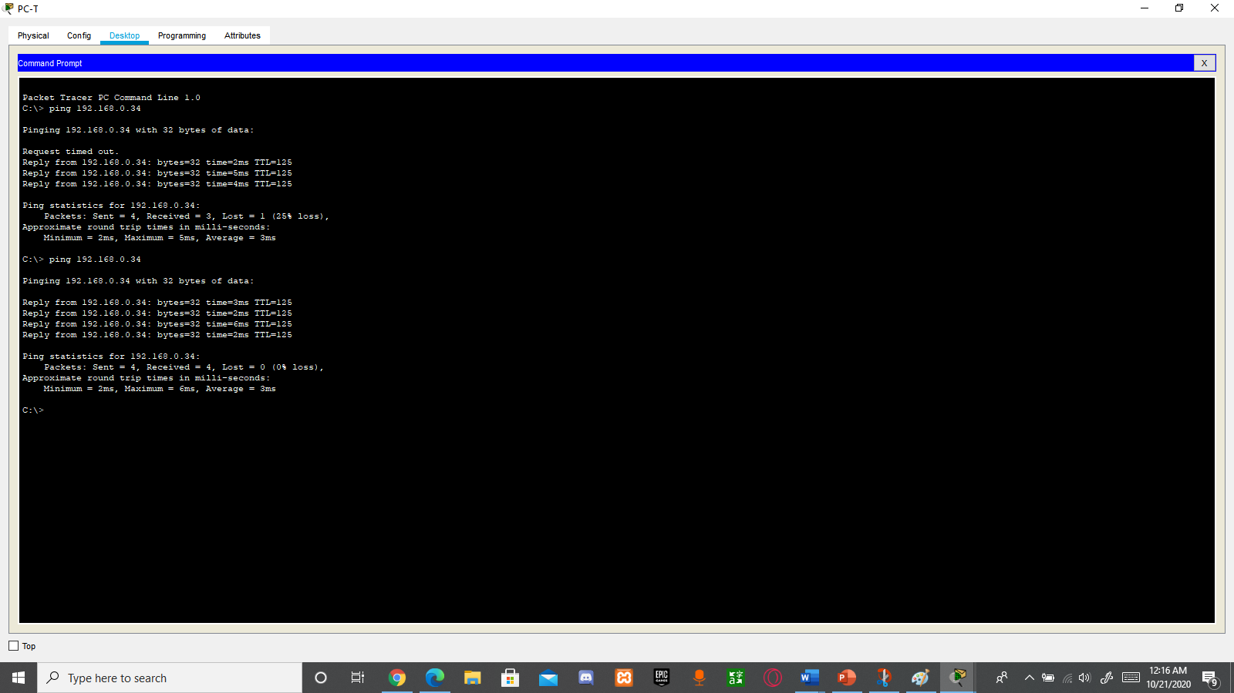
Network Verification
Ping 2nd floor from ground floor(PC T to PC 7).

Slide 16
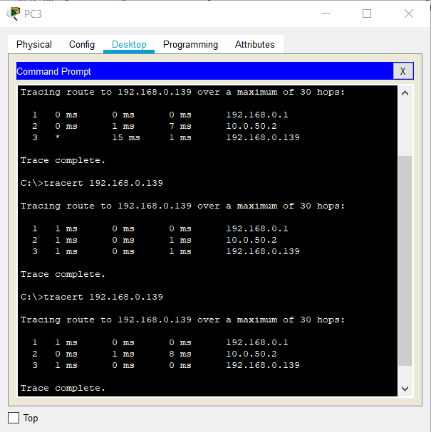
Network Verification
Ping 3rd floor from 1st floor(PC3 to Server 2).

Slide 17
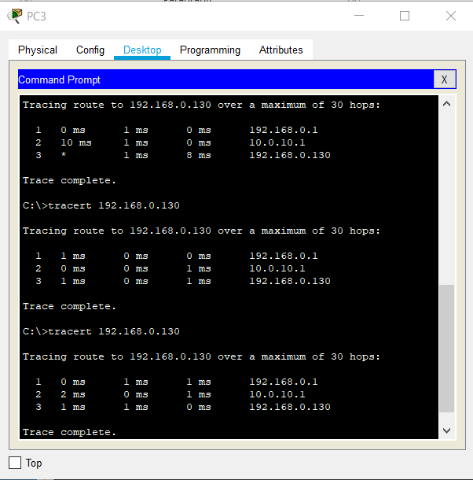
Network Verification
Ping ground floor from 1st floor(PC 3 to Printer1 ).

Slide 18
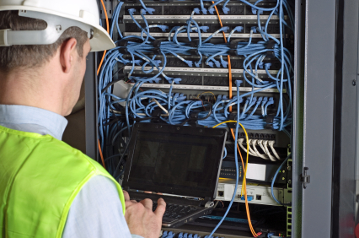
Test Plan and maintainance
This network is designed to provide more cost effectiveness and redundancy.
The use of 4 routers reduces cost and helps load balancing.
It also reduces the risk of network failure.

Slide 19
Maintainance Shedule
Software updates will be checked for the system components on a weekly schedule.
The hardware components such as computers and printers will be checked monthly and routers, servers and switches will be checked weekly.
Documentation of the network should be done weekly.
Security checks should be done weekly.
.

Slide 20
Maintainance Shedule
The system is intended to be used for at least one year before upgrading or enhancing.
The IP addresses for all the floors are configured using DHCP.

Slide 21
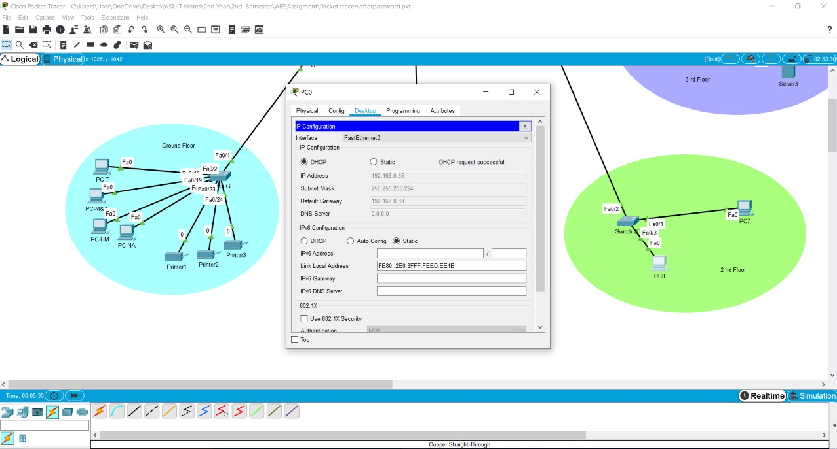
Maintainance Shedule
Using DHCP to configure PC0 of 2nd floor

Slide 22
Security
Port security is enabled on all Switches. All ports which devices are not connected are disables in the first, second and third floors.
Virus guards are installed on all PCs of the network.
All Switches and Routers are protected with console line and privilege mode passwords.
The passwords are encrypted.

Slide 23
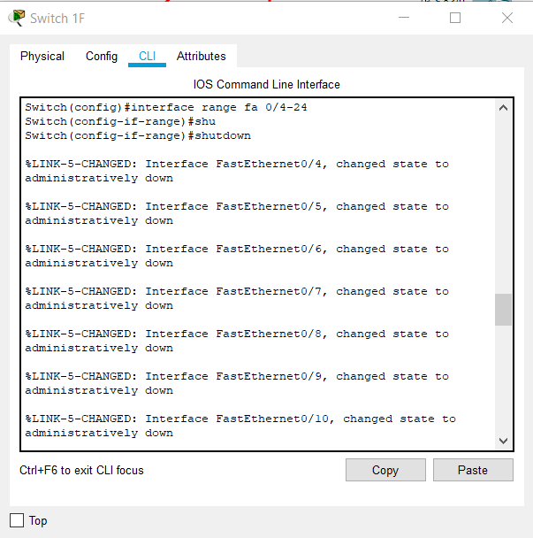
Port security
Disabling(shutting-down) all the un-used ports.

Slide 24
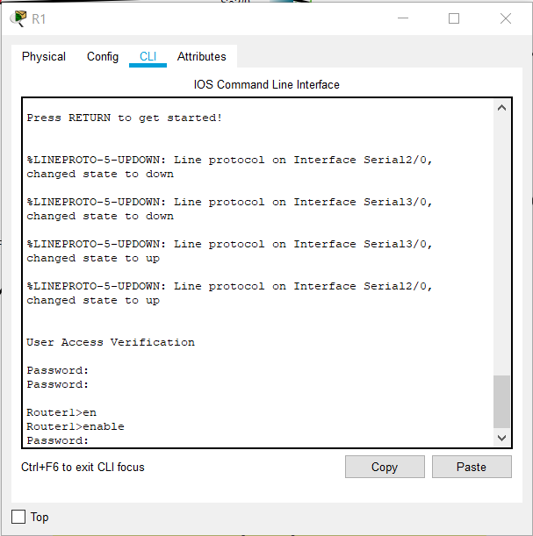
Line Console Password and Enable Password

Slide 25
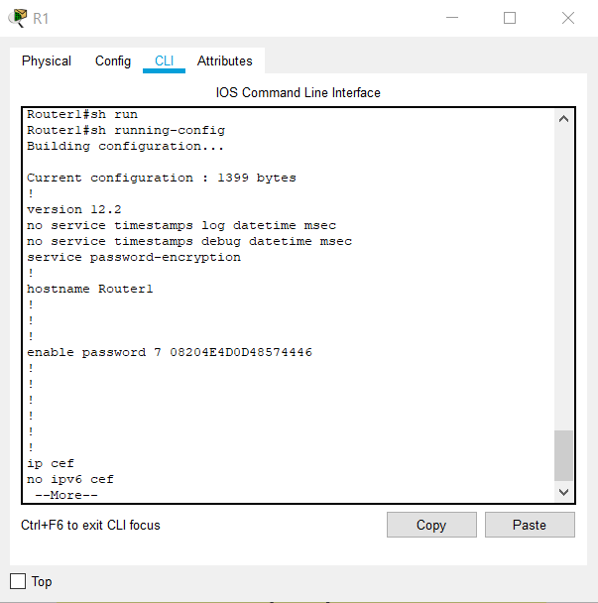
Password Encrypt

Slide 26
THANK you!
ANY QUESTIONS?

